Slide 1
Mini-Project:
Creating a User Interface for IoT System

Slide 2
Skills used in this Project:
C#
HTML
CSS
JavaScript
These are used to create the forms.

Slide 3
Introduction to IoT System
Definition to IoT
IoT is a network of interconnected computing devices embedded in everyday objects, enabling them to send and receive data.

Slide 4
Continuation…..
A common IoT architecture would be made up of these 3 layers:
Perception, or the IoT Device Layer – the client layer that collects data;
Network, or the IoT Gateway Layer – the server-side operators who connect devices to smart objects, servers, and network devices;
Application, or the Platform Layer – the final application that connects the operator, and the client;
Once this is achieved, we move on to the 4 stages of the IoT architecture layout:
Stage 1: Sensors and Actuators;
Stage 2: Gateways and Data Acquisition Systems;
Stage 3: Edge IT Data Processing;
Stage 4: Datacenter and Cloud;

Slide 5
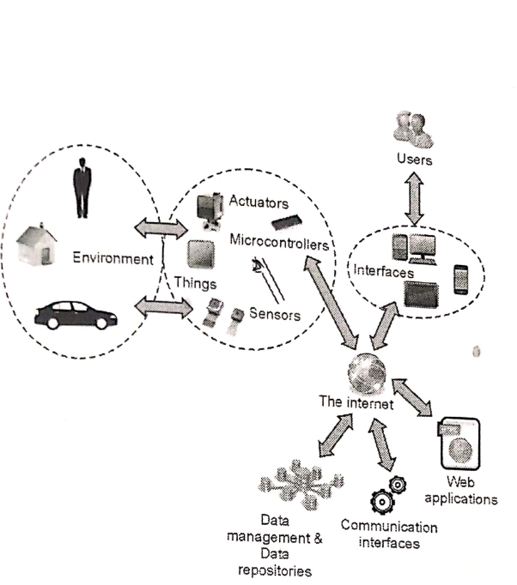
Diagram depicting the working of IoT system
In this project I have created User Interface that is a part of IoT system.

Slide 6
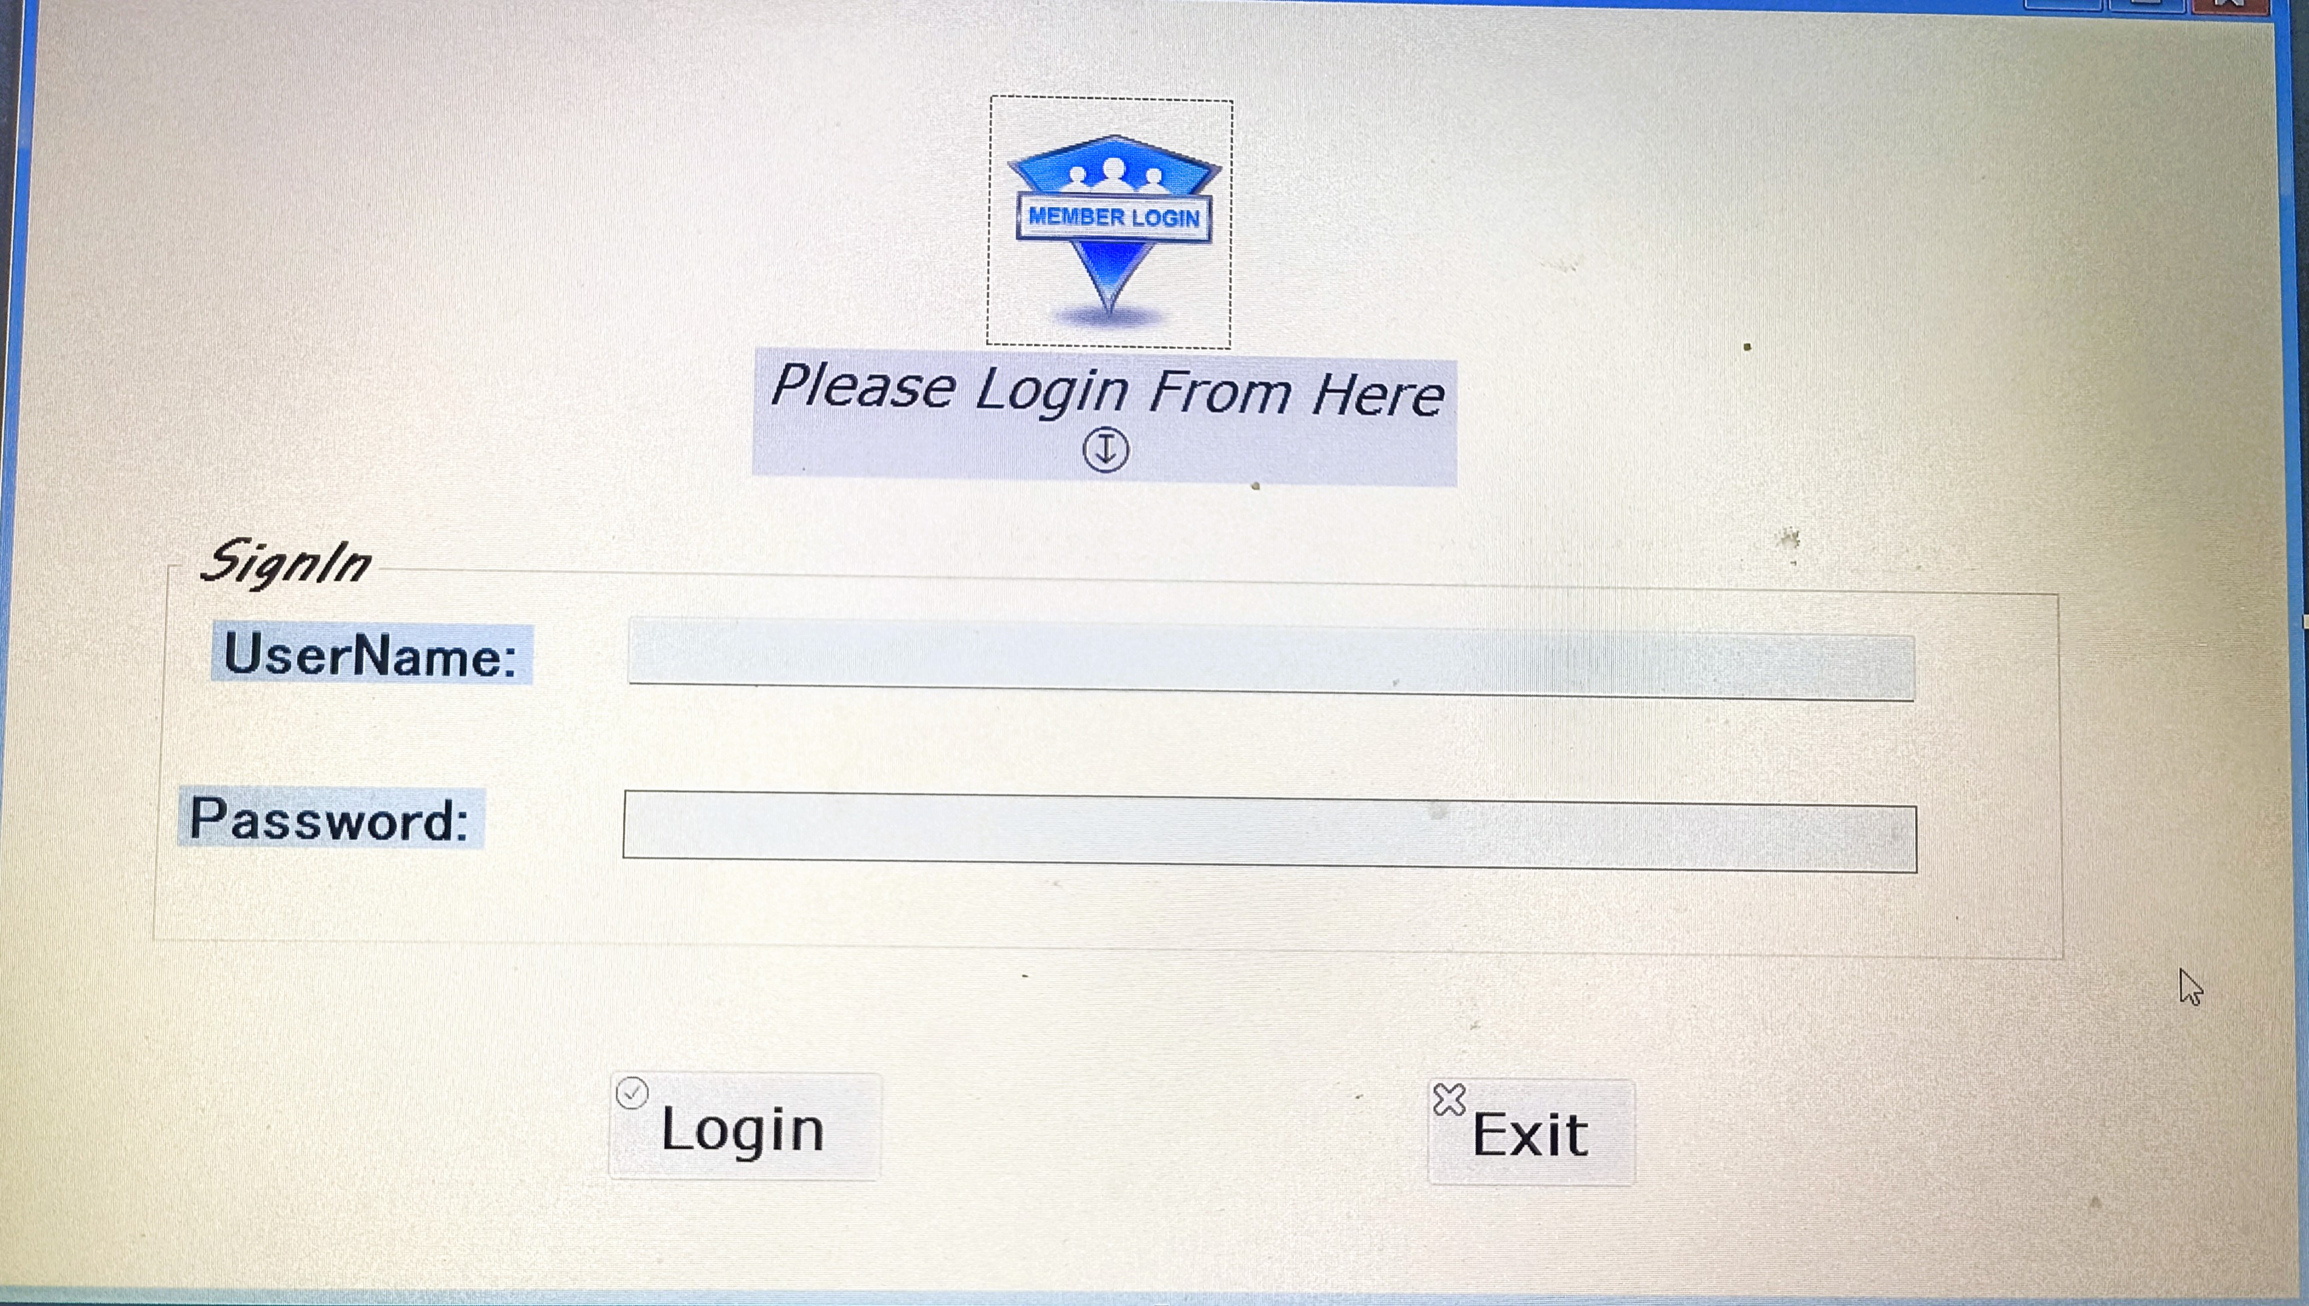
First the Login Page:

Slide 7
The Forms which are made are shown in a flowchart sequence

Slide 8
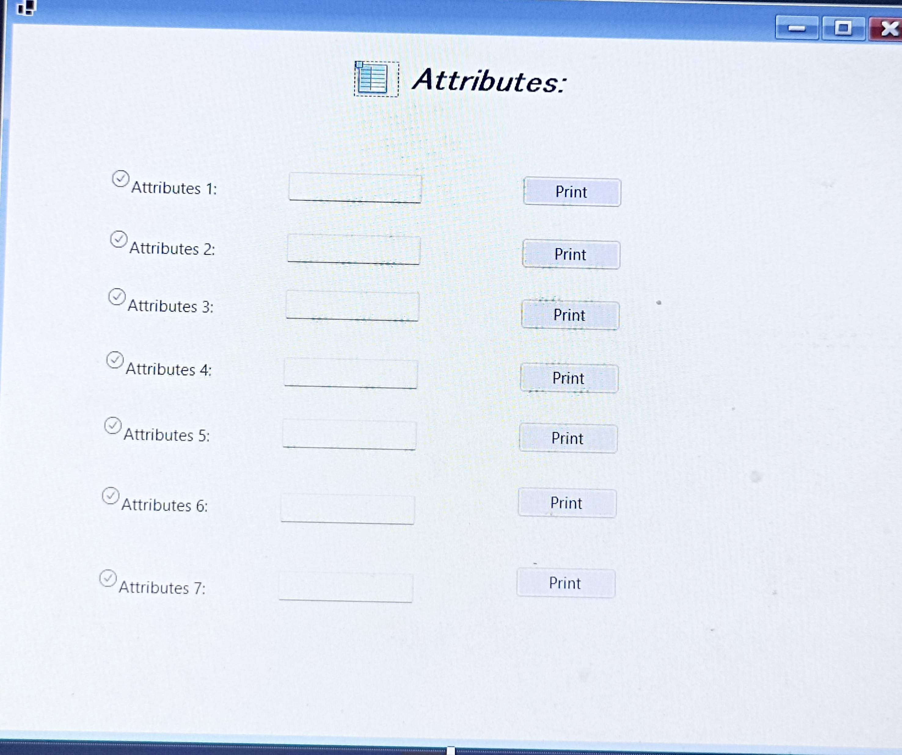
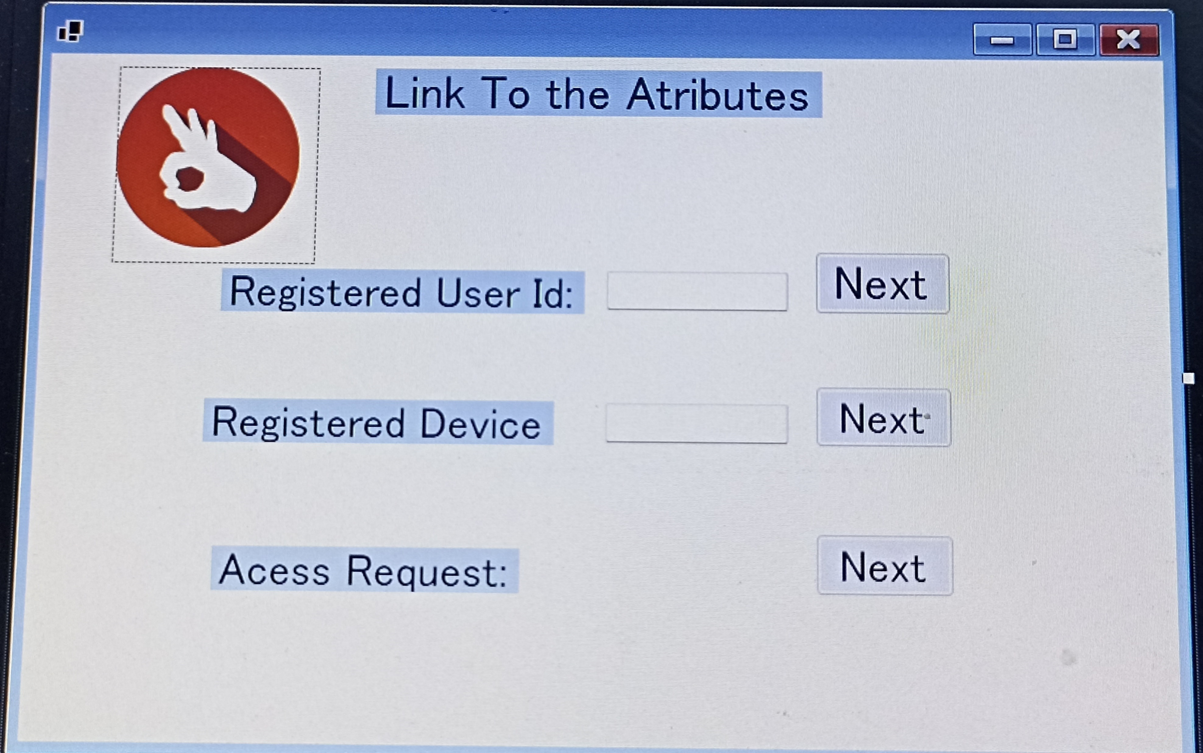
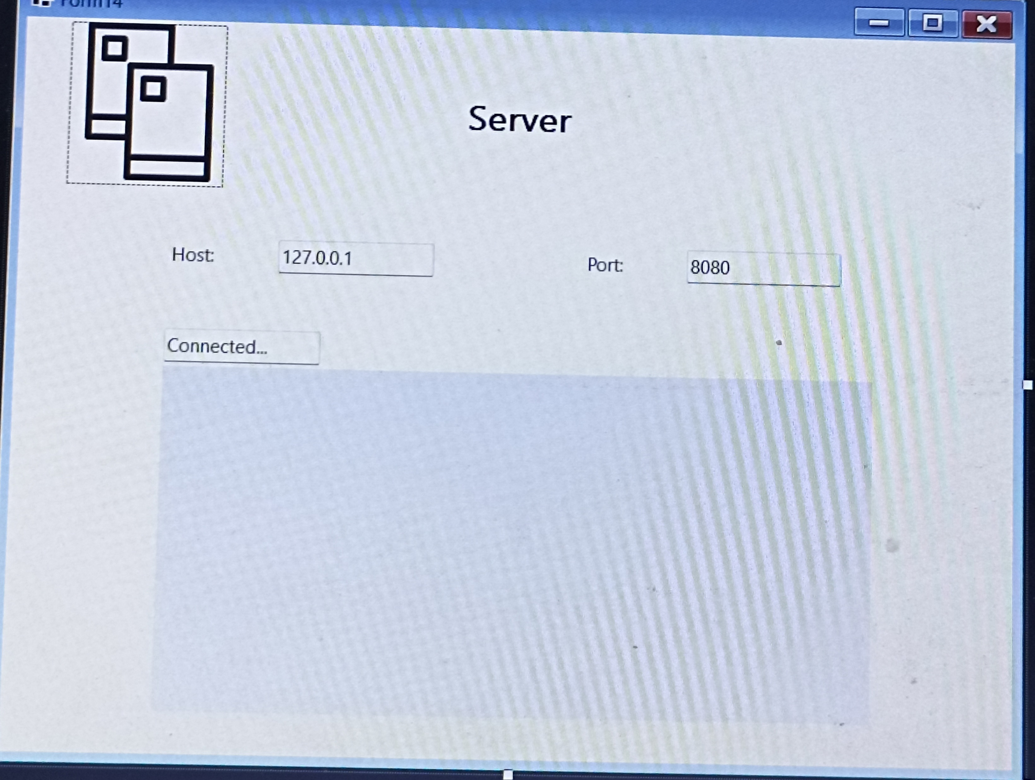
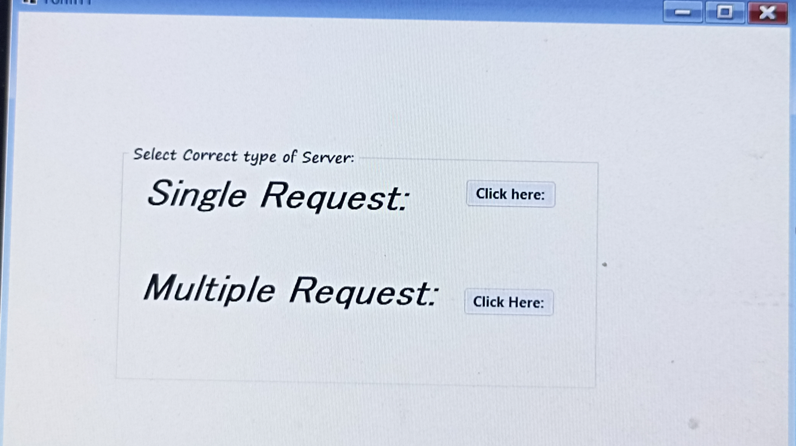
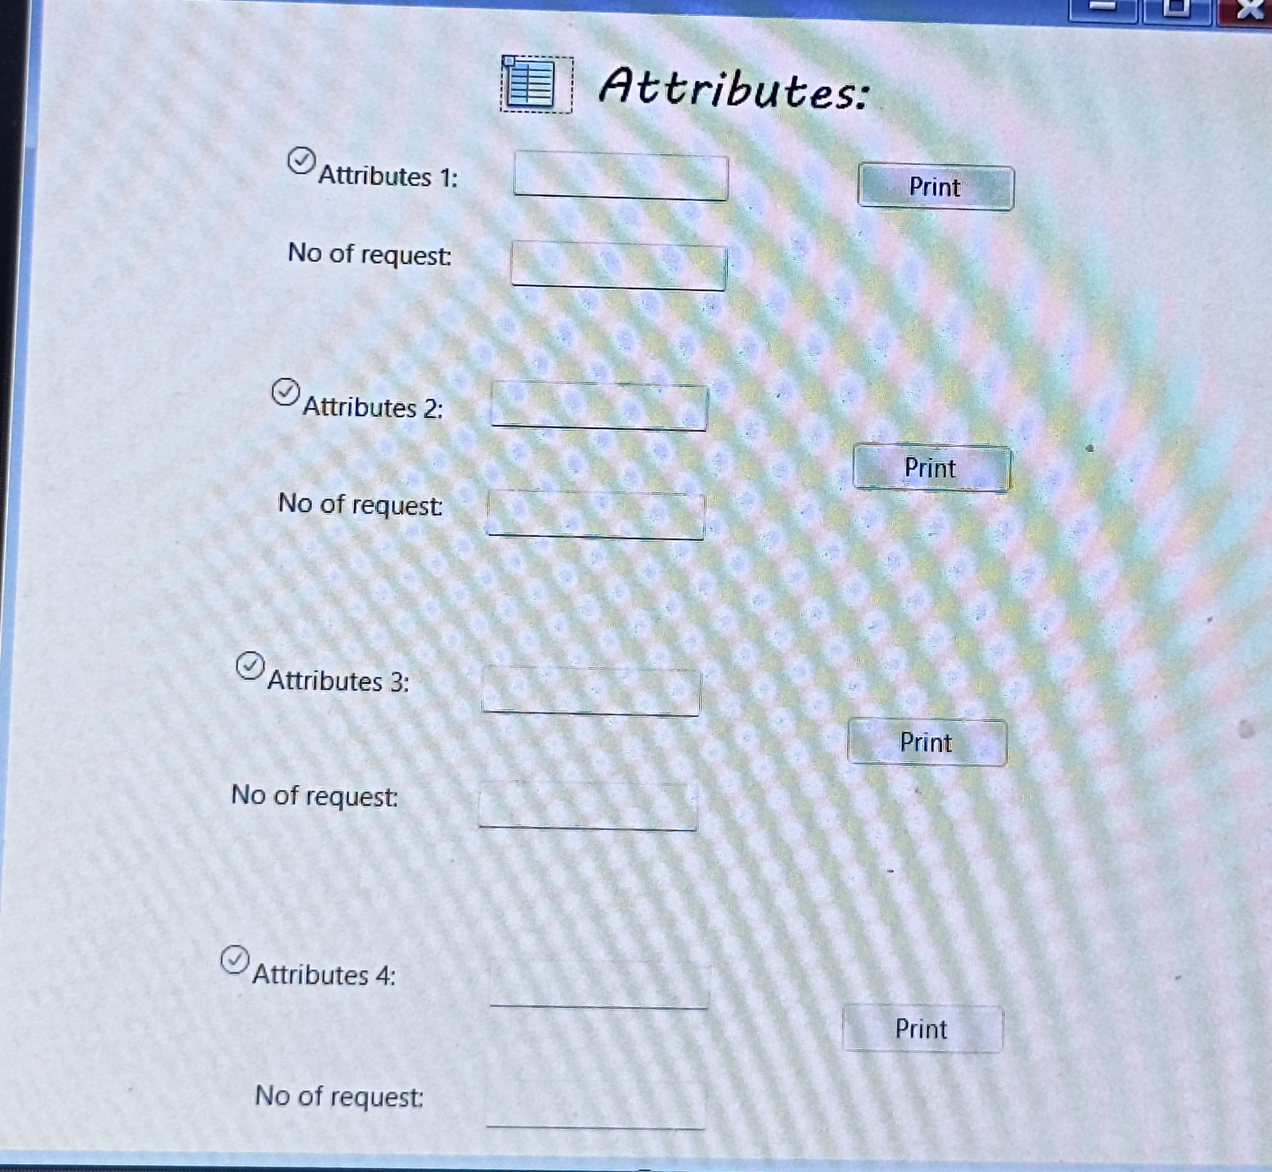
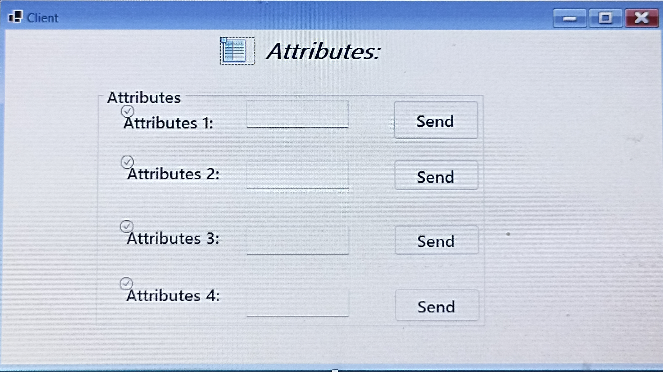

Slide 9
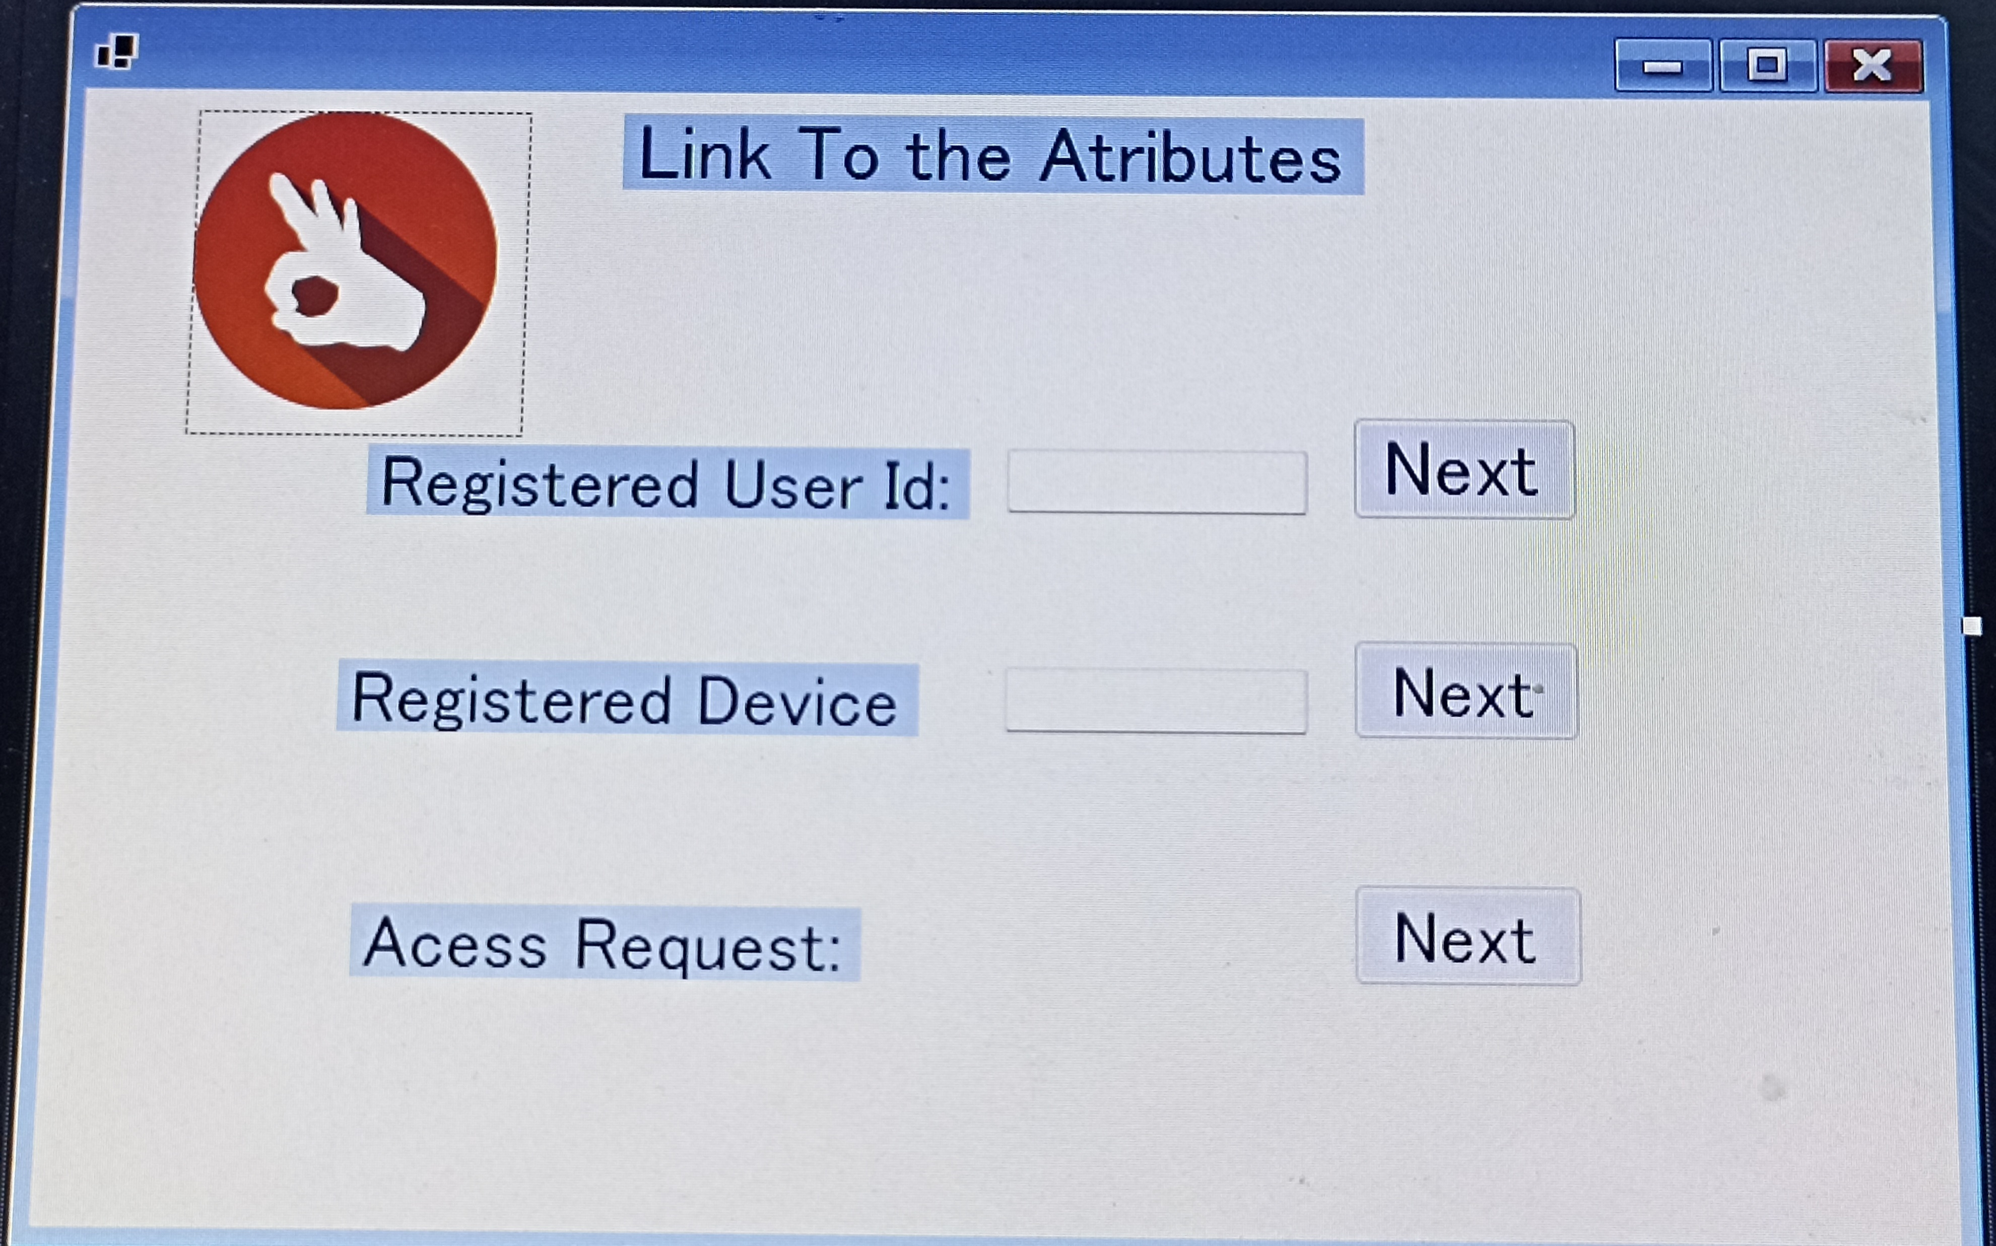
Page 2 Description:
It presents the options of choosing:
To send the attribute of the person with the given user ID
To send the attributes of the registered device with the given ID
To send the attributes given to the server either as a single client request or multiple client requests

Slide 10



Page 3 & 4 Description:
After clicking the next button in the first option then seven of the attributes are entered which are sent to the server.
After clicking the net button in the second option the seven attributes of the registered device are entered and sent to server.

Slide 11
Page 5 ,6 & 7 Description:
It lets us select the type of client request.
And then by single client request option we can send the details as the single client to the server.
And by multiple client options we can send the data multiple times to the server.

Slide 12

Page 8 Description:
The sever window receives the data of the attributes of the registered person, attributes from the registered device, attributes from the single client request, and multiple client requests.
The attribute pages were the Perception, or the IoT Device Layer – the client layer that collects data.
The login page and the options page where three options were there registered ID, registered device, and access request type act as Application, or the Platform Layer – the final application that connects the operator, and the client;
The server page which acts as Network, or the IoT Gateway Layer – the server-side operators who connect devices to smart objects, servers, and network devices.

Slide 13



Conclusion
I have designed a User Interface for IoT systems using the IDE Visual Studio 2022.

